Slide 1

The Link Layer
Computer Networks
Introduction to the Link Layer
Error-Detection and -Correction Techniques
Multiple Access Links and Protocols
Switched Local Area Networks
Link Virtualization: a Network as a Link Layer
Data Center Networking
Retrospective: A Day in the Life of a Web Page Request

Slide 2
Link layer and LANs: our goals
understand principles behind link layer services:
error detection, correction
sharing a broadcast channel: multiple access
link layer addressing
practice: instantiation, implementation of various link layer technologies
Ethernet
VLANs
MPLS
data center networks

Slide 3
Link layer, LANs: roadmap
introduction
error detection, correction
multiple access protocols
LANs
addressing, ARP
Ethernet
switches
VLANs
link virtualization: MPLS
data center networking
Chapter 1-6 synthesis: a day in the life of a web request

Slide 4








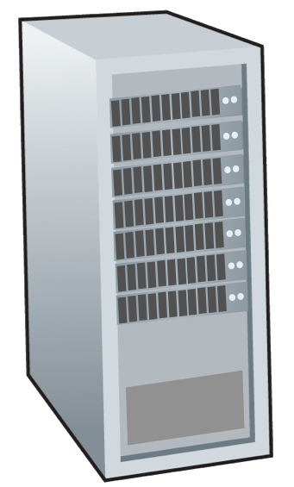







Link layer: introduction
terminology:
hosts, routers: nodes
communication channels that directly connect physically adjacent nodes: links
wired , wireless
LANs
layer-2 packet: frame, encapsulates datagram
mobile network
national or global ISP
datacenter
network
link layer has responsibility of
transferring datagram from one node
to physically adjacent node over a link
enterprise
network

Slide 5
Link layer: context
transportation analogy:
trip from Princeton to Lausanne
limo: Princeton to JFK
plane: JFK to Geneva
train: Geneva to Lausanne
tourist = datagram
transport segment = communication link
transportation mode = link-layer protocol
travel agent = routing algorithm
datagram transferred by different link protocols over different links:
e.g., WiFi on first link, Ethernet on next link
each link protocol provides different services
e.g., may or may not provide reliable data transfer over link

Slide 6


Link layer: services
framing, link access:
encapsulate datagram into frame, adding header, trailer
channel access if shared medium
“MAC” addresses in frame headers identify source, destination (different from IP address!)
reliable delivery between adjacent nodes
we already know how to do this!
seldom used on low bit-error links
wireless links: high error rates
Q: why both link-level and end-end reliability?
…
…
Cable access
cellular
Ethernet LANs
WiFi

Slide 7
Link layer: services (more)
…
flow control:
pacing between adjacent sending and receiving nodes
error detection:
errors caused by signal attenuation, noise.
receiver detects errors, signals retransmission, or drops frame
error correction:
receiver identifies and corrects bit error(s) without retransmission
half-duplex and full-duplex:
with half duplex, nodes at both ends of link can transmit, but not at same time
…
Cable access
cellular
Ethernet LANs
WiFi

Slide 8
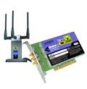
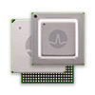

Host link-layer implementation
in each-and-every host
link layer implemented on-chip or in network interface card (NIC)
implements link, physical layer
attaches into host’s system buses
combination of hardware, software, firmware
application
transport
network
link
cpu
memory
host bus
(e.g., PCI)
controller
link
physical
physical
network interface

Slide 9
Interfaces communicating
application
transport
network
link
application
transport
network
link
cpu
memory
memory
CPU
datagram
link_{h}
datagram
controller
controller
datagram
link_{h}
link
physical
link
physical
physical
physical
sending side:
encapsulates datagram in frame
adds error checking bits, reliable data transfer, flow control, etc.
receiving side:
looks for errors, reliable data transfer, flow control, etc.
extracts datagram, passes to upper layer at receiving side

